Slide 1

Reforming Public Services in an Age of Austerity
James Mitchell
Challenges
Reforms
Leadership
After the Referendum:
Constitutional Change in the Event of a No Vote
Notes:
Issues to be addressed regardless of outcome of referendum
Focus on three broad themes – Challanges
Reforms
Leadership – touching on some of matters under debate.

Slide 2
challenges
DEMOGRAPHIC
Over the next 20 years demography alone could increase expenditure on health and social care by 70 per cent.
1,042,00 pensioners in 2010
1,315,000 pensioners by 2035
INSTITUTIONAL
‘For a small country, Scotland has a plethora of institutions, including 32 local authorities, 23 NHS bodies, 8 police forces, 20 universities, 43 colleges, and over 1000 other public bodies.’
Independent Budget Review report July 2010.
FINANCIAL
‘… a long hard financial winter, which will require very difficult choices to be made about priorities’
Auditor General June 2010
Notes:
There are many challenges ahead but I want to focus on three sets of inter-connected challenges ahead:
DEMOGRAPHIC – essentially an ageing population
FINANCIAL – cuts ahead – Mr Osborne’s statement last week - £25bn after the next UK election – unlikely to be reversed by any alternative govt
INSTITUTIONAL – quote here from Indepedent Budget Review (Crawford Beveridge) report. It is worth noting what has happened subsequently in each of these areas.. what next? Institutional reform is often favoured when not clear what else to do…
These are inter-connected of course.
Let’s take each in turn….

Slide 3
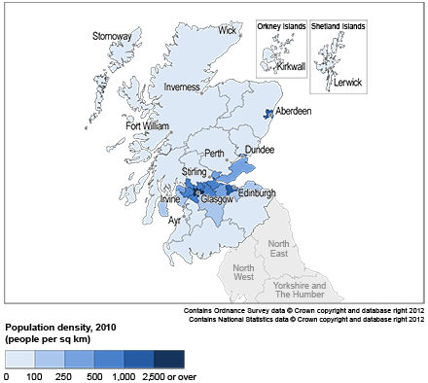
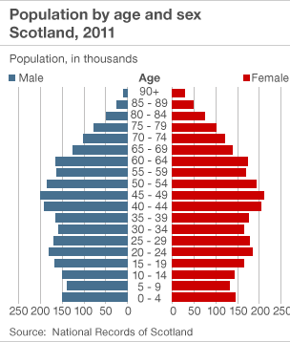
Demography
2011 Census:
∙ More people over 65 (16% of pop) than under 15 (17%) for first time
∙ Av no. of people per square kilometre is 69 (amongst lowest in EU) but huge variations
Notes:
Demographic
This gives a sense of the nature of the challenge but the challenge is more than simply having a growing elderly population – many aspects – one I would want to highlight is an obvious one but one that has interesting implications – where people live/are concentrated. The nature of service provision will differ according to both demography and geography especially in the provision of welfare services.
Some interesting developments and innovations taking place in some far flung places – great myth of urban Scotland being radical and rural Scotland being backward.

Slide 4
Two Views:
Demography
CHALLENGE
Population aged 65 and over “… is estimated to increase by 21 per cent between 2006 and 2016, and will be 62 per cent bigger by 2031. For those aged 85 and over, the population will rise by 38 per cent by 2016 and 144 per cent by 2031. This is particularly significant, as the need for care is far greater among the over 85 population…
“around £4.5 billion was spent in total on health and social care for people aged over 65 in 2006-2007… this figure will need to increase by £1.1 billion by 2016, and by £3.5 billion, or 74 per cent, by 2031.”
Reshaping Care for Older People, Scottish Government, 2010.
- OPPORTUNITY
“Older people are a wonderful resource for their families and communities, and in the formal or informal workforce. They are a repository of knowledge. They can help us avoid making the same mistakes again. Indeed, if we can ensure older people live healthier as well as longer lives, if we can make sure that we are stretching life in the middle and not just at the end, these extra years can be as productive as any others. The societies that adapt to this changing demographic can reap a sizeable “longevity dividend”, and will have a competitive advantage over those that do not.”
Dr Margaret Chan, Director-General of World Health Organisation, 2012
Notes:
Demographic challenges often seen as major problem – listen to programmes on radio or read the press – it has become too common to assume problems.
Having a population that is growing older should be seen as an objective – though it would be more so if the spread of growth was equally spread –
2008 World Health Organization commissioned research on the social factors determining health – chaired by Sir Michael Marmot and his colleagues took Glasgow as an example of stark health inequities, noting that a boy in the deprived area of Calton had an average life expectancy of 54 years compared with a boy from affluent Lenzie, 12 km away in East Dunbartonshire, who could expect to live to 82. [In Glasgow the gap is bigger. The difference in life expec- tancy between the most deprived and least deprived areas was 6·9 years in 1981–85; 20 years later this rate had increased to almost 12 years]
Different perspectives – especially when we recognise the important role many older people ply in providing services (captured well in quote from Director-General of World Health Organisation).

Slide 5
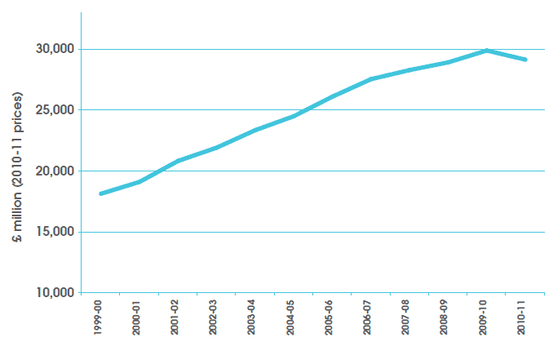


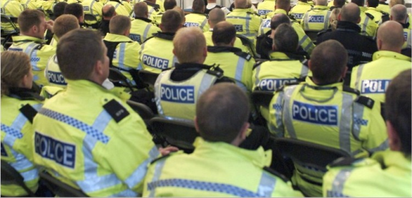
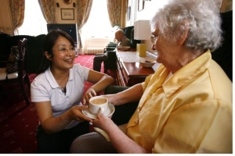
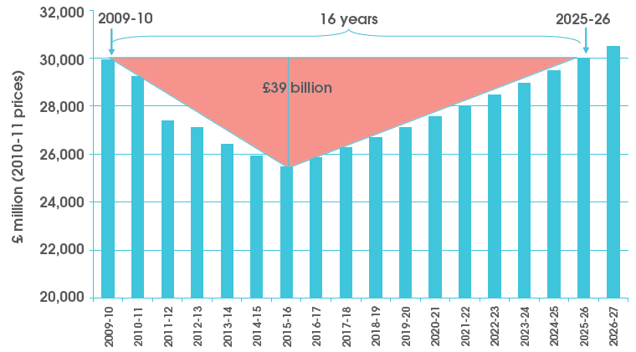
Financial
Interests
Bureaucracy
Policies
Notes:
FINANCIAL
Graphs on right are favourites – first showing increasing expenditure over years coinciding with (and in no way caused by) devolution – helped bed devo down for sure – as exemplified by photos on right Middle class students celebrating – got degrees without having to pay fees up front.
5% annual increase in expenditure was phenomenal growth. But the graph below was an attempt back in 2010 to estimate how long it would be before spending levels got back to where they were before the crisis (assuming this was course chosen!). It proved wrong – too optimistic – always difficult to predict – further away from present, more difficult to predict beyond the broadest sense (treat preditions as highly speculative) – key point is the trajectory.
One related problem (illustrated by bottom left) is to recall that interests don’t create policies so much as policies crate interests – once a policy is in place, it creates a community of interest to keep it – thus making it difficult to reverse a policy. Not impossible but a challenge ahead for any government or aspiring government to attract support.

Slide 6
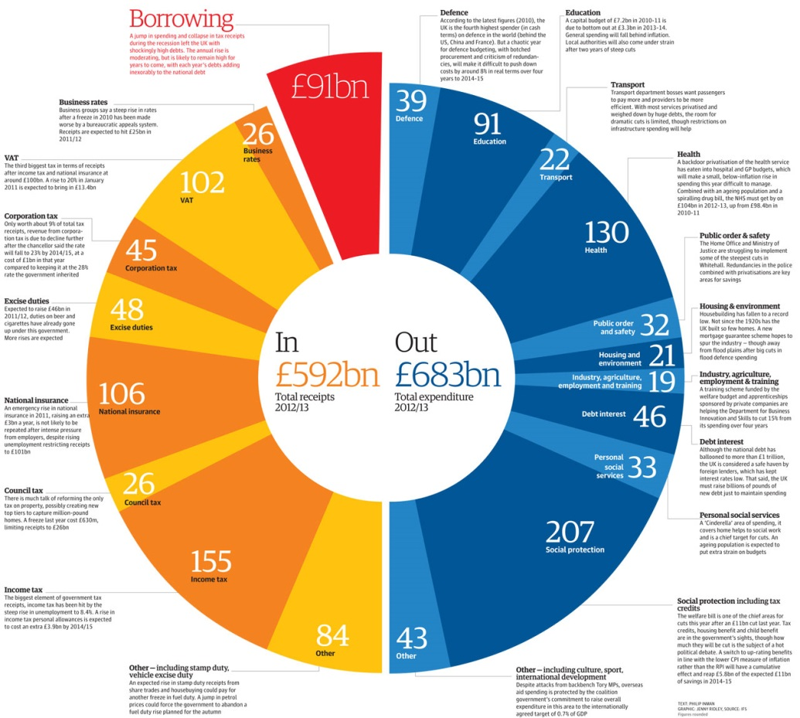
“The debate about the future of public services needs to face up to the fact that good services cost money. We need to be mature about how we raise that money in terms of both fair taxation and a fair charging regime that reflects local priorities. Cutting public services is not the only way to cut debt: raising taxes for those who can afford to pay more and clamping down on tax avoidance will also reduce the deficit.”
UNISON Scotland, submission to the Independent Budget Review, 2010
Financial
Scandinavian levels of services
American levels of taxation
“We remain opposed to the use of Scotland’s tax-varying power because of the additional cost and complexity that would be placed on employers. If the Calman Report is adopted by the UK government, we would support the devolved ten pence income tax rate remaining on a par with the rest of the UK but we would oppose any increase because Scotland’s tax competitiveness would deteriorate.”
CBI Scotland, 2009
Notes:
FINANCIAL (again)
Really picks up on last – this is about hard choices – the cliché that we want American levels of taxation but Scandinavian levels of services (leaving aside what the latter really means) leads to imbalances. Difficult choices will have to be made.
This will be central to local governance – that is where policy is delivered.
Ignore talk about Scottish vs British welfare state – welfare is only meaningful in our local communities, in families and with people.

Slide 7
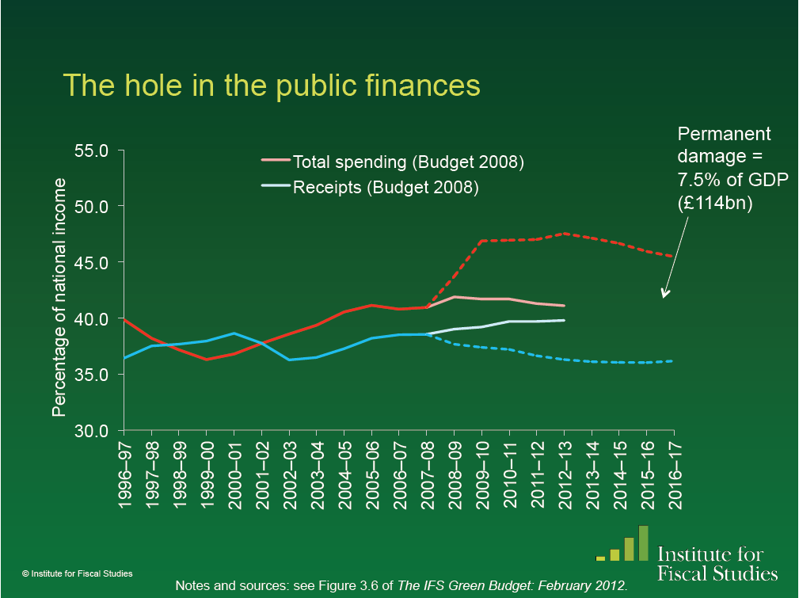
‘By the end of 2011–12, 73% of the planned tax increases will have been implemented. The spending cuts, however, are largely still to come – only 12% of the planned total cuts to public service spending, and just 6% of the cuts in current public service spending, will have been implemented by the end of this financial year.’
(IFS 2012: 47)
‘The composition of the planned tightening varies over time, with the tax rises being much more front-loaded than the spending cuts. By the end of 2011–12, the plans imply that we will have experienced 73% of the tax rises, 34% of the investment cuts, 12% of the benefit cuts, but just 6% of the cuts to non-investment spending on public services.’
(IFS 2012: 55)
Financial
Notes:
FINANCIAL 3
This quote – and many others could be chosen – from Institute for Fiscal Studies is sobering. As is the graph – again, any number of such graphs and again ignore the details, focus on trajectory.
We are, indeed, in for a ‘long cold winter in public spending (regardless of what happens in the referendum).

Slide 8
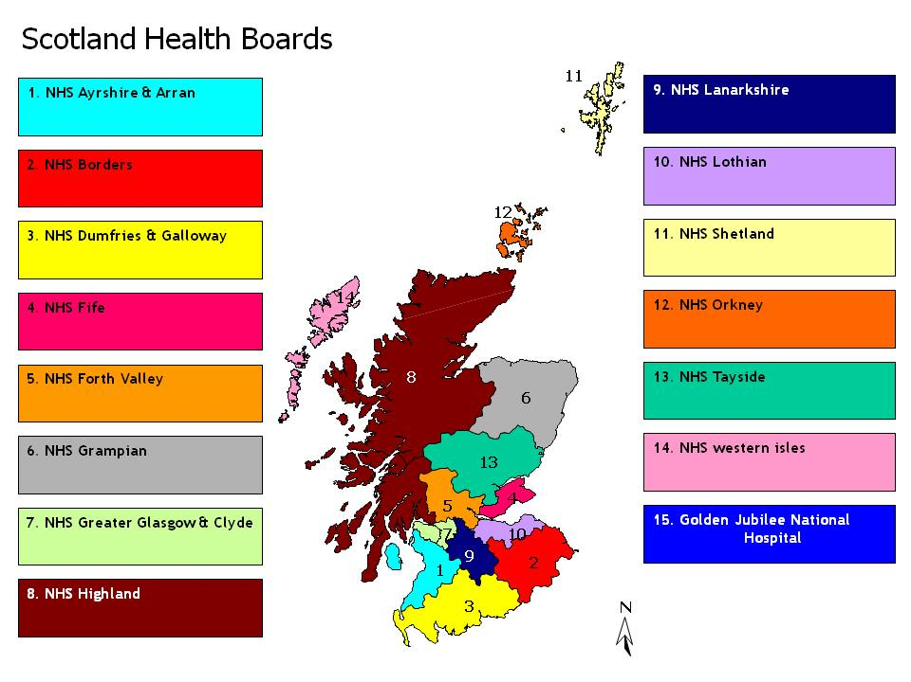
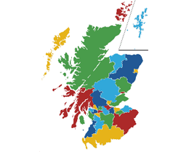
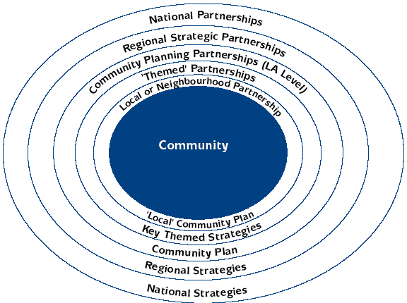
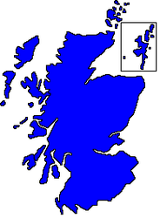
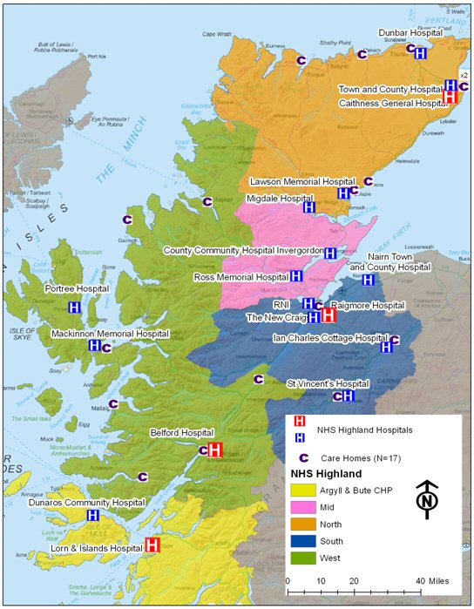
32 local Authorities
Institutional
Police Service
Fire & Rescue
Organisation within a Health Board
Notes:
INSTITUTIONAL
Many institutional challenges ahead – we continue to debate relationship between levels of government as if this is all important – far more challenging are relations at local level between different institutions. IGR between Edinburgh and London works well (and would under almost any constitutional scenario) so long as there is a will to make it work. The issue is largely one of ideological differences (far more important than party incongruence).
But the perennial – perhaps it can never be resolved without a much more root and branch approach – issue of relations between different agencies. We are in our umpteenth iteration of this debate in Scotland. Community Planning Partnerships is important but can this really achieve what it sets out to achieve without creating single budget lines for example?
And in financially difficult times, tendency for professionals to turn back into their silos (classically illustrated in different explanations of public disorder).

Slide 9

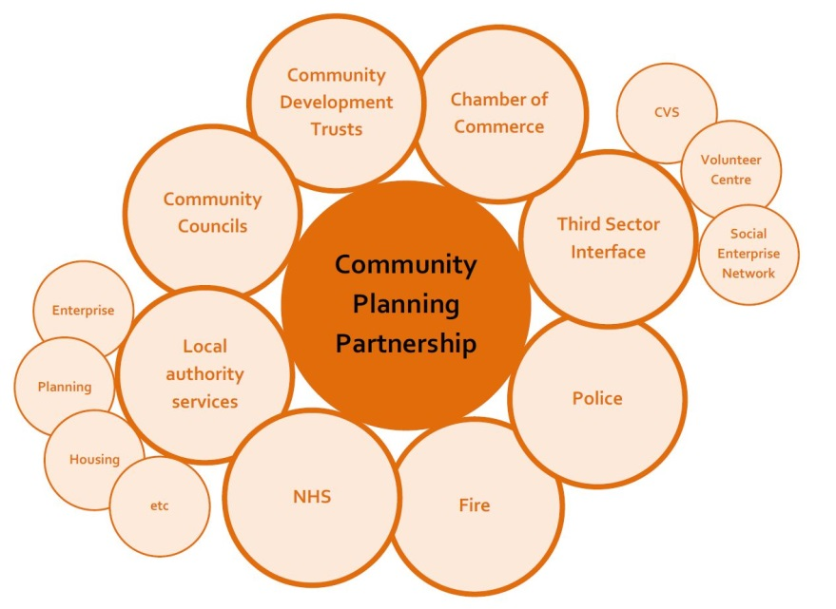

Health & Social
Institutional
Riots and disorder
Police:
Law & order
Social Work:
Poverty
Notes:
INSTITUTIONAL
Many institutional challenges ahead – we continue to debate relationship between levels of government as if this is all important – far more challenging are relations at local level between different institutions. IGR between Edinburgh and London works well (and would under almost any constitutional scenario) so long as there is a will to make it work. The issue is largely one of ideological differences (far more important than party incongruence).
But the perennial – perhaps it can never be resolved without a much more root and branch approach – issue of relations between different agencies. We are in our umpteenth iteration of this debate in Scotland. Community Planning Partnerships is important but can this really achieve what it sets out to achieve without creating single budget lines for example?
And in financially difficult times, tendency for professionals to turn back into their silos (classically illustrated in different explanations of public disorder).

Slide 10
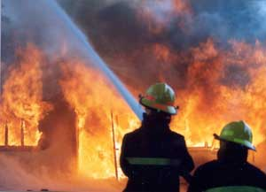

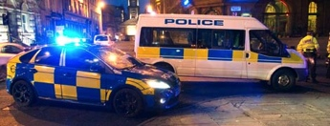
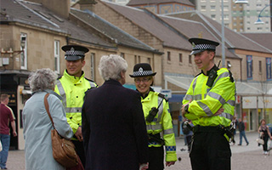
Cultural
Notes:
INSTITUTIONAL/CULTURAL
Leads onto institutional (or what some prefer to call CULTURAL challenges.
Semper Vigilo = Always vigilant – Police Scotland motto but vigilance in what sense?
There have been major strides in some services – fire service has been fascinating (and more successful than policing) but, again, a constant battle.
Convincing fire service personnel that they should be knocking on doors and explaining fire prevention is not easy. People join fire service to drive big red engines with flashing lights fast and to put out fires – not knock on doors. Each new set of recruits has to be socialised into what is a very new culture.
Under Alasdair Hay, Tayside with 145,000 houses – fire service entered 60,000 homes in three years – people trust firemen.
Consider that across the range of public services.

Slide 11

Christie’s Pillars & Proposals
DELIVERY, DELIVERY, DELIVERY, DELIVERY, DELIVERY, DELIVERY, DELIVERY, DELIVERY, DELIVERY, DELIVERY, DELIVERY, DELIVERY, DELIVERY, DELIVERY, DELIVERY, DELIVERY, DELIVERY, DELIVERY, DELIVERY, DELIVERY, DELIVERY, DELIVERY, DELIVERY, DELIVERY, DELIVERY, DELIVERY, DELIVERY, DELIVERY, DELIVERY, DELIVERY, DELIVERY, DELIVERY, DELIVERY, DELIVERY, DELIVERY, DELIVERY, DELIVERY, DELIVERY, DELIVERY, DELIVERY, DELIVERY, DELIVERY, DELIVERY, DELIVERY, DELIVERY, DELIVERY, DELIVERY, DELIVERY, DELIVERY, DELIVERY, DELIVERY, DELIVERY, DELIVERY, DELIVERY, DELIVERY, DELIVERY, DELIVERY, DELIVERY, DELIVERY, DELIVERY, DELIVERY, DELIVERY, DELIVERY, DELIVERY, DELIVERY, DELIVERY, DELIVERY, DELIVERY, DELIVERY, DELIVERY, DELIVERY, DELIVERY, DELIVERY, DELIVERY, DELIVERY, DELIVERY, DELIVERY, DELIVERY, DELIVERY, DELIVERY, DELIVERY, DELIVERY, DELIVERY, DELIVERY, DELIVERY, DELIVERY, DELIVERY, DELIVERY, DELIVERY, DELIVERY, DELIVERY, DELIVERY, DELIVERY, DELIVERY, DELIVERY, DELIVERY, DELIVERY, DELIVERY, DELIVERY, DELIVERY, DELIVERY, DELIVERY, DELIVERY, DELIVERY, DELIVERY, DELIVERY, DELIVERY, DELIVERY, DELIVERY, DELIVERY, DELIVERY, DELIVERY, DELIVERY, DELIVERY, DELIVERY, DELIVERY, DELIVERY, DELIVERY, DELIVERY, DELIVERY, DELIVERY, DELIVERY, DELIVERY, DELIVERY, DELIVERY, DELIVERY, DELIVERY, DELIVERY, DELIVERY, DELIVERY, DELIVERY, DELIVERY, DELIVERY, DELIVERY, DELIVERY, DELIVERY, DELIVERY, DELIVERY, DELIVERY, DELIVERY, DELIVERY, DELIVERY, DELIVERY, DELIVERY, DELIVERY, DELIVERY, DELIVERY, DELIVERY, DELIVERY, DELIVERY, DELIVERY, DELIVERY, DELIVERY, DELIVERY, DELIVERY, DELIVERY, DELIVERY, DELIVERY, DELIVERY, DELIVERY, DELIVERY, DELIVERY, DELIVERY, DELIVERY, DELIVERY, DELIVERY, DELIVERY, DELIVERY, DELIVERY, DELIVERY, DELIVERY, DELIVERY, DELIVERY, DELIVERY, DELIVERY, DELIVERY, DELIVERY, DELIVERY, DELIVERY, DELIVERY, DELIVERY, DELIVERY, DELIVERY, DELIVERY, DELIVERY, DELIVERY, DELIVERY, DELIVERY, DELIVERY, DELIVERY, DELIVERY, DELIVERY, DELIVERY, DELIVERY, DELIVERY, DELIVERY, DELIVERY, DELIVERY, DELIVERY, DELIVERY, DELIVERY, DELIVERY, DELIVERY, DELIVERY, DELIVERY, DELIVERY, DELIVERY, DELIVERY, DELIVERY, DELIVERY, DELIVERY, DELIVERY, DELIVERY, DELIVERY, DELIVERY, DELIVERY, DELIVERY, DELIVERY, DELIVERY, DELIVERY, DELIVERY, DELIVERY, DELIVERY, DELIVERY, DELIVERY, DELIVERY, DELIVERY, DELIVERY, DELIVERY, DELIVERY, DELIVERY, DELIVERY, DELIVERY, DELIVERY, DELIVERY, DELIVERY, DELIVERY, DELIVERY, DELIVERY, DELIVERY, DELIVERY, DELIVERY, DELIVERY, DELIVERY, DELIVERY, DELIVERY, DELIVERY, DELIVERY, DELIVERY, DELIVERY, DELIVERY, DELIVERY, DELIVERY, DELIVERY, DELIVERY, DELIVERY, DELIVERY, DELIVERY, DELIVERY, DELIVERY, DELIVERY, DELIVERY, DELIVERY, DELIVERY, DELIVERY, DELIVERY, DELIVERY, DELIVERY, DELIVERY, DELIVERY, DELIVERY, DELIVERY, DELIVERY, DELIVERY, DELIVERY, DELIVERY, DELIVERY, DELIVERY, DELIVERY, DELIVERY, ERY, DELIVERY, DELIVERY, DELIVERY, DELIVERY, DELIVERY, DELIVERY, DELIVERY, DELIVERY, DELIVERY, DELIVERY, DELIVERY, DELIVERY, DELIVERY, DELIVERY, DELIVERY, DELIVERY, DELIVERY, DELIVERY, DELIVERY, DELIVERY, DELIVERY, DELIVERY, DELIVERY, DELIVERY, DELIVERY, DELIVERY, DELIVERY, DELIVERY, DELIVERY, DELIVERY, DELIVERY, DELIVERY, DELIVERY, DELIVERY, DELIVERY, DELIVERY, DELIVERY, DELIVERY, DELIVERY, DELIVERY, DELIVERY, DELIVERY, DELIVERY, DELIVERY, DELIVERY, DELIVERY, DELIVERY, DELIVERY, DELIVERY, DELIVERY, DELIVERY, DELIVERY, DELIVERY, DELIVERY, DELIVERY, DELIVERY, DELIVERY, DELIVERY, DELIVERY, DELIVERY, DELIVERY, DELIVERY, DELIVERY, DELIVERY, DELIVERY, DELIVERY, DELIVERY, DELIVERY, DELIVERY, DELIVERY, DELIVERY, DELIVERY, DELIVERY, DELIVERY, DELIVERY, DELIVERY, DELIVERY, DELIVERY, DELIVERY, DELIVERY, DELIVERY, DELIVERY, DELIVERY, DELIVERY, DELIVERY, DELIVERY, DELIVERY, DELIVERY, DELIVERY, DELIVERY, DELIVERY, DELIVERY, DELIVERY, DELIVERY, DELIVERY, DELIVERY, DELIVERY, DELIVERY, DELIVERY, DELIVERY, DELIVERY, DELIVERY, DELIVERY, DELIVERY, DELIVERY, DELIVERY, DELIVERY, DELIVERY, DELIVERY, DELIVERY, DELIVERY, DELIVERY, DELIVERY, DELIVERY, DELIVERY, DELIVERY, DELIVERY, DELIVERY, DELIVERY, DELIVERY, DELIVERY, DELIVERY, DELIVERY, DELIVERY, DELIVERY, DELIVERY, DELIVERY, DELIVERY, DELIVERY, DELIVERY, DELIVERY, DELIVERY, DELIVERY, DELIVERY, DELIVERY, DELIVERY, DELIVERY, DELIVERY, DELIVERY, DELIVERY, DELIVERY, DELIVERY, DELIVERY, DELIVERY, DELIVERY, DELIVERY, DELIVERY, DELIVERY, DELIVERY, DELIVERY, DELIVERY, DELIVERY, DELIVERY, DELIVERY, DELIVERY, DELIVERY, DELIVERY, DELIVERY, DELIVERY, DELIVERY, DELIVERY, DELIVERY, DELIVERY, DELIVERY, DELIVERY, DELIVERY, DELIVERY, DELIVERY, DELIVERY, DELIVERY, DELIVERY, DELIVERY, DELIVERY, DELIVERY, DELIVERY, DELIVERY, DELIVERY, DELIVERY, DELIVERY, DELIVERY, DELIVERY, DELIVERY, DELIVERY, DELIVERY, DELIVERY, DELIVERY, DELIVERY, DELIVERY, DELIVERY, DELIVERY, DELIVERY, DELIVERY, DELIVERY, DELIVERY, DELIVERY, DELIVERY, DELIVERY, DELIVERY, DELIVERY, DELIVERY, DELIVERY, DELIVERY, DELIVERY, DELIVERY, DELIVERY, DELIVERY, DELIVERY, DELIVERY, DELIVERY, DELIVERY, DELIVERY, DELIVERY, DELIVERY, DELIVERY, DELIVERY, DELIVERY, DELIVERY, DELIVERY, DELIVERY, DELIVERY, DELIVERY, DELIVERY, DELIVERY, DELIVERY, DELIVERY, DELIVERY, DELIVERY, DELIVERY, DELIVERY, DELIVERY, DELIVERY, DELIVERY, DELIVERY, DELIVERY, DELIVERY, DELIVERY, DELIVERY, DELIVERY, DELIVERY, DELIVERY, DELIVERY, DELIVERY, DELIVERY, DELIVERY, DELIVERY, DELIVERY, DELIVERY, DELIVERY, DELIVERY, DELIVERY, DELIVERY, DELIVERY, DELIVERY, DELIVERY, DELIVERY, DELIVERY, DELIVERY, DELIVERY, DELIVERY, DELIVERY, DELIVERY, DELIVERY, DELIVERY, DELIVERY, DELIVERY, DELIVERY, DELIVERY, DELIVERY, DELIVERY, DELIVERY, DELIVERY, DELIVERY, DELIVERY, DELIVERY, DELIVERY, DELIVERY, DELIVERY, DELIVERY, DELIVERY, DELIVERY, DELIVERY, DELIVERY, DELIVERY, DELIVERY, DELIVERY, DELIVERY, DELIVERY, DELIVERY, DELIVERY, DELIVERY, DELIVERY, DELIVERY, DELIVERY, DELIVERY, DELIVERY, DELIVERY, DELIVERY, DELIVERY, DELIVERY, DELIVERY, DELIVERY, DELIVERY, DELIVERY, DELIVERY, DELIVERY, DELIVERY, DELIVERY, DELIVERY, DELIVERY, DELIVERY, DELIVERY, DELIVERY, DELIVERY, DELIVERY, DELIVERY, DELIVERY, DELIVERY, DELIVERY, DELIVERY, DELIVERY, DELIVERY, DELIVERY, DELIVERY, DELIVERY, DELIVERY, DELIVERY, DELIVERY, DELIVERY, DELIVERY, DELIVERY, DELIVERY, DELIVERY, DELIVERY, DELIVERY, DELIVERY, DELIVERY, DELIVERY, DELIVERY, DELIVERY, DELIVERY, DELIVERY, DELIVERY, DELIVERY, DELIVERY, DELIVERY, DELIVERY, DELIVERY, DELIVERY, DELIVERY, DELIVERY, DELIVERY, DELIVERY, DELIVERY, DELIVERY, DELIVERY, DELIVERY, DELIVERY, DELIVERY, DELIVERY, DELIVERY, DELIVERY, DELIVERY, DELIVERY, DELIVERY, DELIVERY, DELIVERY, DELIVERY, DELIVERY, DELIVERY, DELIVERY, DELIVERY, DELIVERY, DELIVERY, DELIVERY, DELIVERY, DELIVERY, DELIVERY, DELIVERY, DELIVERY, DELIVERY, DELIVERY, DELIVERY, DELIVERY, DELIVERY, DELIVERY, DELIVERY, DELIVERY, DELIVERY, DELIVERY, DELIVERY, DELIVERY, DELIVERY, DELIVERY, DELIVERY, DELIVERY, DELIVERY, DELIVERY, DELIVERY, DELIVERY, DELIVERY, DELIVERY, DELIVERY, DELIVERY, DELIVERY, DELIVERY, DELIVERY, DELIVERY, DELIVERY, DELIVERY, DELIVERY, DELIVERY, DELIVERY, DELIVERY, DELIVERY, DELIVERY, DELIVERY, DELIVERY, DELIVERY, DELIVERY, DELIVERY, DELIVERY, DELIVERY, DELIVERY, DELIVERY, DELIVERY, DELIVERY, DELIVERY, DELIVERY, DELIVERY, DELIVERY, DELIVERY, DELIVERY, DELIVERY, DELIVERY, DELIVERY, DELIVERY, DELIVERY, DELIVERY, DELIVERY, DELIVERY, DELIVERY, DELIVERY, DELIVERY, DELIVERY, DELIVERY, DELIVERY, DELIVERY, DELIVERY, DELIVERY, DELIVERY, DELIVERY, DELIVERY, DELIVERY, DELIVERY, DELIVERY, DELIVERY, DELIVERY, DELIVERY, DELIVERY, DELIVERY, DELIVERY, DELIVERY, DELIVERY, DELIVERY, DELIVERY, DELIVERY, DELIVERY, DELIVERY, DELIVERY, DELIVERY, DELIVERY, DELIVERY, DELIVERY, DELIVERY, DELIVERY, DELIVERY, DELIVERY, DELIVERY, DELIVERY, DELIVERY, DELIVERY, DELIVERY, DELIVERY, DELIVERY, DELIVERY, DELIVERY, DELIVERY, DELIVERY, DELIVERY, DELIVERY, DELIVERY, DELIVERY, DELIVERY, DELIVERY, DELIVERY, DELIVERY, DELIVERY, DELIVERY, DELIVERY, DELIVERY, DELIVERY, DELIVERY, DELIVERY, DELIVERY, DELIVERY, DELIVERY, DELIVERY, DELIVERY, DELIVERY, DELIVERY, DELIVERY, DELIVERY, DELIVERY, DELIVERY, DELIVERY, DELIVERY, DELIVERY, DELIVERY, DELIVERY, DELIVERY, DELIVERY, DELIVERY, DELIVERY, DELIVERY, DELIVERY, DELIVERY, DELIVERY, DELIVERY, DELIVERY, DELIVERY, DELIVERY, DELIVERY, DELIVERY, DELIVERY, DELIVERY, DELIVERY, DELIVERY, DELIVERY, DELIVERY, DELIVERY, DELIVERY, DELIVERY, DELIVERY, DELIVERY, DELIVERY, DELIVERY, DELIVERY, DELIVERY, DELIVERY, DELIVERY, DELIVERY, DELIVERY, DELIVERY, DELIVERY, DELIVERY, DELIVERY, DELIVERY, DELIVERY, DELIVERY, DELIVERY, DELIVERY, DELIVERY, DELIVERY, DELIVERY, DELIVERY, DELIVERY, DELIVERY, DELIVERY, DELIVERY, DELIVERY, DELIVERY, DELIVERY, DELIVERY, DELIVERY, DELIVERY, DELIVERY, DELIVERY, DELIVERY, DELIVERY, DELIVERY, DELIVERY, DELIVERY, DELIVERY, DELIVERY, DELIVERY, DELIVERY, DELIVERY, DELIVERY, DELIVERY, DELIVERY, DELIVERY, DELIVERY, DELIVERY, DELIVERY, DELIVERY, DELIVERY, DELIVERY, DELIVERY, DELIVERY, DELIVERY, DELIVERY, DELIVERY, DELIVERY, DELIVERY, DELIVERY, DELIVERY, DELIVERY, DELIVERY, DELIVERY, DELIVERY, DELIVERY, DELIVERY, DELIVERY, DELIVERY, DELIVERY, DELIVERY, DELIVERY, DELIVERY, DELIVERY, DELIVERY, DELIVERY, DELIVERY, DELIVERY, DELIVERY, DELIVERY, DELIVERY, DELIVERY, DELIVERY, DELIVERY, DELIVERY, DELIVERY, DELIVERY, DELIVERY, DELIVERY, DELIVERY, DELIVERY, DELIVERY, DELIVERY, DELIVERY, DELIVERY, DELIVERY, DELIVERY, DELIVERY, DELIVERY, DELIVERY, DELIVERY, DELIVERY, DELIVERY, DELIVERY, DELIVERY, DELIVERY, DELIVERY, DELIVERY, DELIVERY, DELIVERY, DELIVERY, DELIVERY, DELIVERY, DELIVERY, DELIVERY, DELIVERY, DELIVERY, DELIVERY, DELIVERY, DELIVERY, DELIVERY, DELIVERY, DELIVERY, DELIVERY, DELIVERY, DELIVERY, DELIVERY, DELIVERY, DELIVERY, DELIVERY, DELIVERY, DELIVERY, DELIVERY, DELIVERY, DELIVERY, DELIVERY, DELIVERY, DELIVERY, DELIVERY, DELIVERY, DELIVERY, DELIVERY, DELIVERY, DELIVERY, DELIVERY, DELIVERY, DELIVERY, DELIVERY, DELIVERY, DELIVERY, DELIVERY, DELIVERY, DELIVERY, DELIVERY, DELIVERY, DELIVERY, DELIVERY, DELIVERY, DELIVERY, DELIVERY, DELIVERY, DELIVERY, DELIVERY, DELIVERY, DELIVERY, DELIVERY, DELIVERY, DELIVERY, DELIVERY, DELIVERY, DELIVERY, DELIVERY, DELIVERY, DELIVERY, DELIVERY, DELIVERY, DELIVERY, DELIVERY, DELIVERY, DELIVERY, DELIVERY, DELIVERY, DELIVERY, DELIVERY, DELIVERY, DELIVERY, DELIVERY, DELIVERY, DELIVERY, DELIVERY, DELIVERY, DELIVERY, DELIVERY, DELIVERY, DELIVERY, DELIVERY, DELIVERY, DELIVERY, DELIVERY, DELIVERY, DELIVERY, DELIVERY, DELIVERY, DELIVERY, DELIVERY, DELIVERY, DELIVERY, DELIVERY, DELIVERY, DELIVERY, DELIVERY, DELIVERY, DELIVERY, DELIVERY, DELIVERY, DELIVERY, DELIVERY, DELIVERY, DELIVERY, DELIVERY, DELIVERY, DELIVERY, DELIVERY, DELIVERY, DELIVERY, DELIVERY, DELIVERY, DELIVERY, DELIVERY, DELIVERY, DELIVERY, DELIVERY, DELIVERY, DELIVERY, DELIVERY, DELIVERY, DELIVERY, DELIVERY, DELIVERY, DELIVERY, DELIVERY, DELIVERY, DELIVERY, DELIVERY, DELIVERY, DELIVERY, DELIVERY, DELIVERY, DELIVERY, DELIVERY, DELIVERY, DELIVERY, DELIVERY, DELIVERY, DELIVERY
Reforms
Reforms must aim to empower individuals and communities receiving public services by involving them in the design and delivery of the services they use.
Public service providers must be required to work much more closely in partnership, to integrate service provision and thus improve the outcomes they achieve.
We must prioritise expenditure on public services which prevent negative outcomes from arising.
And our whole system of public services – public, third and private sectors – must become more efficient by reducing duplication and sharing services wherever possible.
PERSONALISATION
EMPOWERMENT
PARTNERSHIP
ACCOUNTABILITY
FAILURE DEMAND
PREVENTATIVE SPENDING
EARLY INTERVENTION
EFFECTIVENESS
CONSISTENT DATA GATHERING
GREATER TRANSPARENCY
BOTTOM-UP REFORMS

Slide 12
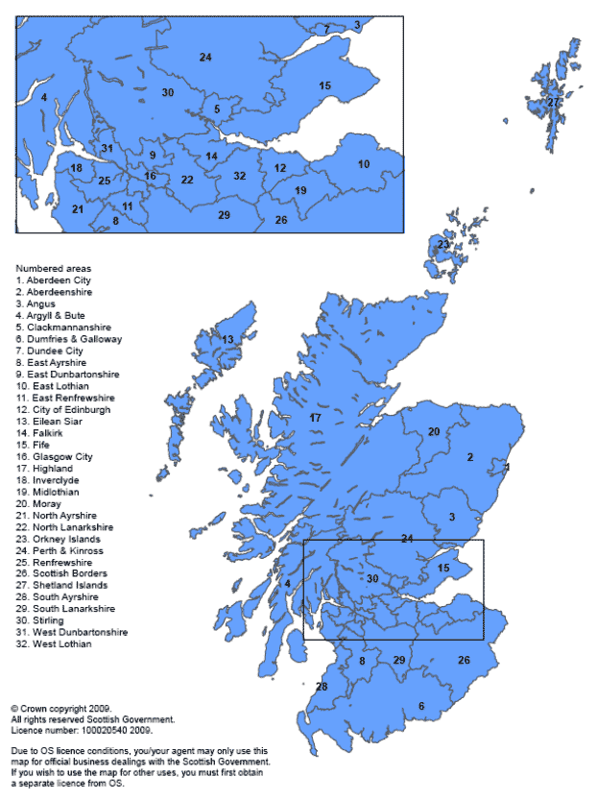
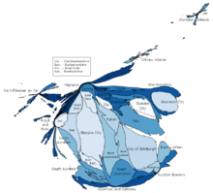
Scotland Population Cartogram.
The size of councils is in proportion to their population; the darker the colour, the bigger the actual area served by a council.
Reforms
An inconvenient spread of people
Notes:
FEWER LOCAL AUTHORITIES?
Not the answer – ignore the silliness from the Scottish press.

Slide 13
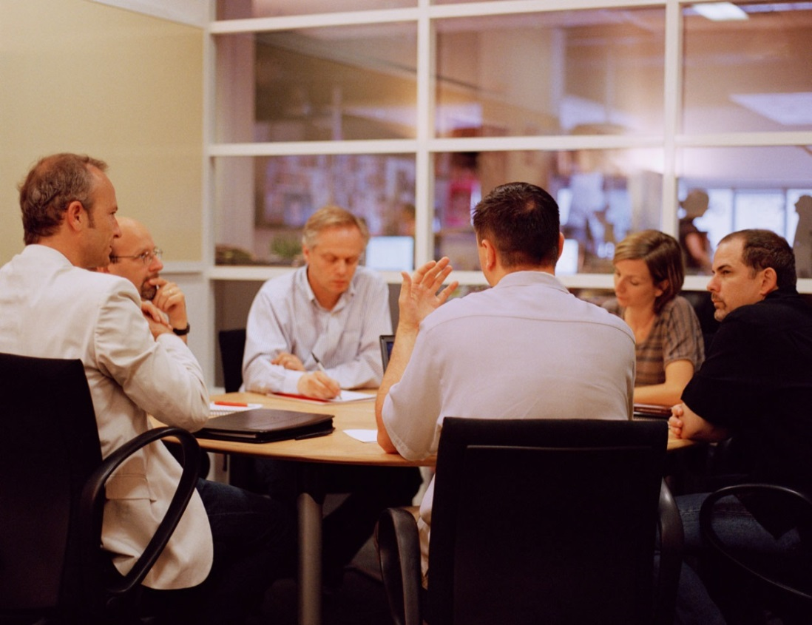
Leadership
CHRISTIE ON LEADERSHIP
‘Outcome-focussed transformation requires strong leadership…’
‘front-line staff seek solutions actively with a ‘can-do’ attitude, empowered by managers and leaders..’
‘Leaders alone cannot provide meaning for the workforce but in helping to clarify the purpose of the organisation, they can help employees renew their own sense of purpose.’
‘We recommend that managers and leaders within public service organisations develop and extend empowerment of front-line staff to support their engagement with people and communities to improve service provision.’
‘Managers and leaders within public service organisations should develop and extend the empowerment of front-line staff, to support their engagement with people and communities.’
‘Many of the problems facing Scottish public services are deeply complex ‘wicked’ issues that sit across and between different government organisations and attempts to treat then as ‘tame’ through a single institutional framework are almost bound to fail.’
Leadership in The Public Sector in Scotland (ESRC Seminar Series: Mapping the Public Policy Landscape) 2009
Notes:
LEADERSHIP
Let me conclude by suggesting – given this is a leadership course – what leadeship is not.
The photo is taken from a cover from an initiative between the Scottish Govt and ERSC on leadership.
This is not leadership but it highlights a problem – people think that senior officials sitting round a table – with a token woman in the picture – is leadership. This is a problem.
Leadership comes in different forms – quotes are taken from Christie on leadership – a subject not specifically addressed by the Commission but evident in the report as involving a much more enabling sense that the top-down approach.
If I could make one plea it would be get out of Holyrood, get out of central offices.

Slide 14

Elections/referendum & PUBLIC POLICY
Spill-over
INSULATED
CORE
Insinuated
PERIPHERAL
Notes:
Elections/Referendums:
Some issues are core to these highly adversarial events – getting caught up in core events is dangerous.
Extent to which it is possible to insulate public policy concerns from elections/referendum depends on issue. But there is a great deal going on that is unaffected by referendum and happens in elections. Creating space to discuss matters calmly will be challenge.
A more adventurous course is to try to INSINUATE an issue/interest into an election/referendum campaign eg Our Islands, Our Future. Challenging both sides to give more autonomy to island councils.
But dangerous, as can slip into heated centre or remains so far out on the periphery to have gained nothing.
CLARITY OF PURPOSE % AVOID TAKING SIDES
University Scotland statement on referendum – can’t avoid contribution but refuses to take sides.
‘never let a serious crisis go to waste’

Slide 15
Reforming Public Services in an Age of Austerity
Further information:
Professor James Mitchell
James.mitchell@ed.ac.uk
After the Referendum:
Constitutional Change in the Event of a No Vote

